Slide 1

File and Storage System HW01: Environment Setup & : Implement System Calls for File System Operation
Department of Computer Science and Information Engineering
Shuo-Han Chen (陳碩漢), shchen@ntut.edu.tw
Hong-Yue Technology Research Building 334
M 15:10 - 18:00
Notes:
Good Afternoon everyone
I am Shuo-Han Chen, a postdoctoral research fellow at Academia Sinica
It is a great honor to be invited by the department for being here today

Slide 2
Requirements of HW01
Setup a virtual machine with CentOS 7 and Compile NachOS -> 20%
: Implement System Calls for File System Operation -> 70%
You need to finish Step 3 to get this 70%
Visit our GitLab website & upload your results -> 10%
Then, form a report and submit it through i-study
Follow the template strictly. Points will be ducted if the template is not followed
Deadline: 4/15 Friday 23:59
No late submission
2
Notes:
Here is more detail about me. I started working as a postdoctoral research fellow at the Institute of Information Science, Academia Sinica since March 2018
During my fellowship, I have been to the Purdue University USA and the Chinese University of Hong Kong for visiting
Before my fellowship, I spent two and half years for my phd degree at the CS Department of National Tsing Hua University
My research interests mainly lies in
the next generation memory/storage architecture designs
Emerging non-volatile memory and storage technologies
Low power system designs for artificial neural networks
In the past few years, I have revived few awards and a best paper nomination at DAC conference, which is a top rated conference in the EDA field

Slide 3

Part I. Setup a Virtual Machine with CentOS 7 and Compile NachOS
Notes:
Thank you for listening. Now, I would like to end today’s talk by the Q & A time.

Slide 4
VM with CentOS
Download the image file from http://ftp.tc.edu.tw/Linux/CentOS/7.9.2009/isos/x86_64/CentOS-7-x86_64-DVD-2009.iso
Choose your favorite virtual machine tool
You can use VMware Workstation 16 Player
https://www.vmware.com/tw/products/workstation-player/workstation-player-evaluation.html
Choose personal use, then it’s free
Create a new virtual machine instance
20 GB Disk, 4 GB RAM, 2 core
4
Notes:
Here is more detail about me. I started working as a postdoctoral research fellow at the Institute of Information Science, Academia Sinica since March 2018
During my fellowship, I have been to the Purdue University USA and the Chinese University of Hong Kong for visiting
Before my fellowship, I spent two and half years for my phd degree at the CS Department of National Tsing Hua University
My research interests mainly lies in
the next generation memory/storage architecture designs
Emerging non-volatile memory and storage technologies
Low power system designs for artificial neural networks
In the past few years, I have revived few awards and a best paper nomination at DAC conference, which is a top rated conference in the EDA field

Slide 5
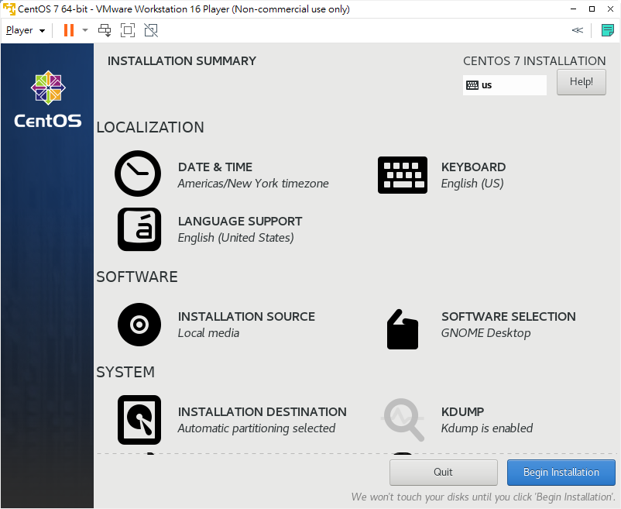
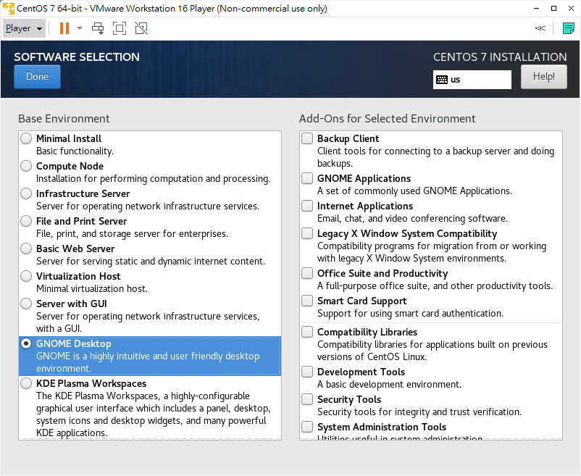
Things to be Careful of
Remember to change to installation type “GNOME Desktop”
Or you will end up with no GUI
5
Notes:
Here is more detail about me. I started working as a postdoctoral research fellow at the Institute of Information Science, Academia Sinica since March 2018
During my fellowship, I have been to the Purdue University USA and the Chinese University of Hong Kong for visiting
Before my fellowship, I spent two and half years for my phd degree at the CS Department of National Tsing Hua University
My research interests mainly lies in
the next generation memory/storage architecture designs
Emerging non-volatile memory and storage technologies
Low power system designs for artificial neural networks
In the past few years, I have revived few awards and a best paper nomination at DAC conference, which is a top rated conference in the EDA field

Slide 6
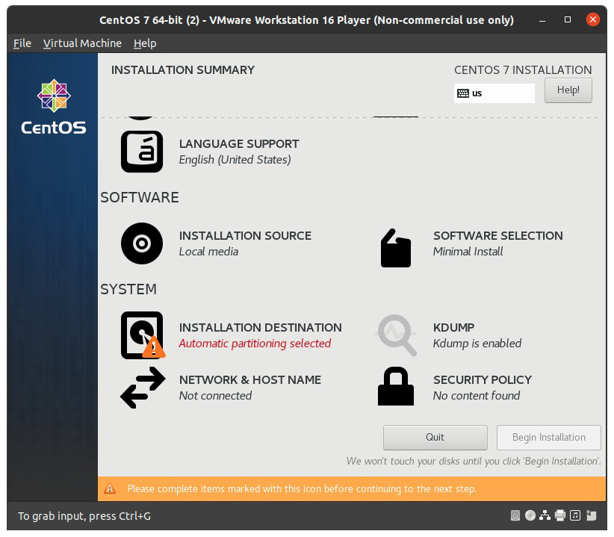
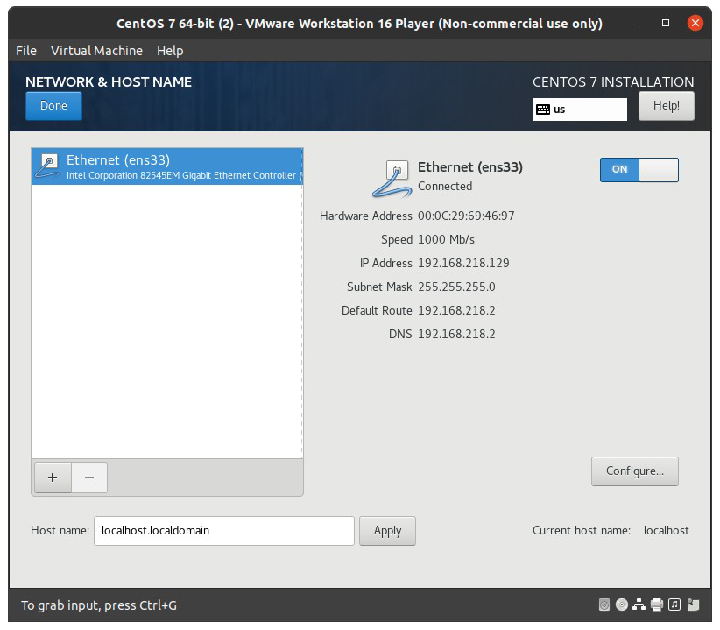
Things to be Careful of
Remember to enable network
6
Notes:
Here is more detail about me. I started working as a postdoctoral research fellow at the Institute of Information Science, Academia Sinica since March 2018
During my fellowship, I have been to the Purdue University USA and the Chinese University of Hong Kong for visiting
Before my fellowship, I spent two and half years for my phd degree at the CS Department of National Tsing Hua University
My research interests mainly lies in
the next generation memory/storage architecture designs
Emerging non-volatile memory and storage technologies
Low power system designs for artificial neural networks
In the past few years, I have revived few awards and a best paper nomination at DAC conference, which is a top rated conference in the EDA field

Slide 7
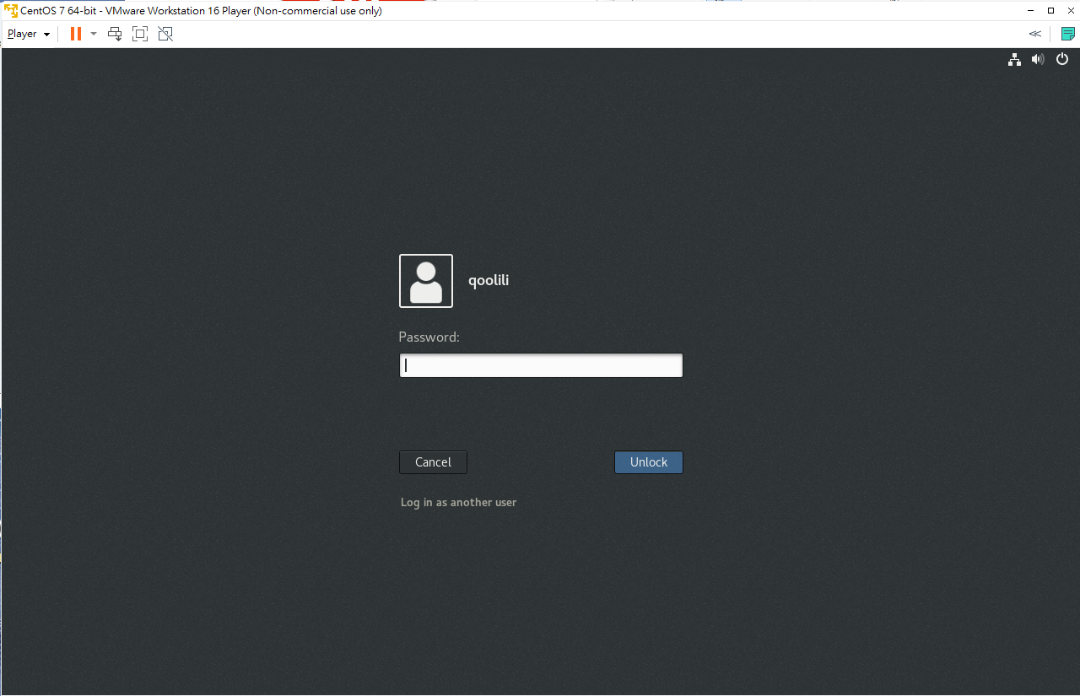
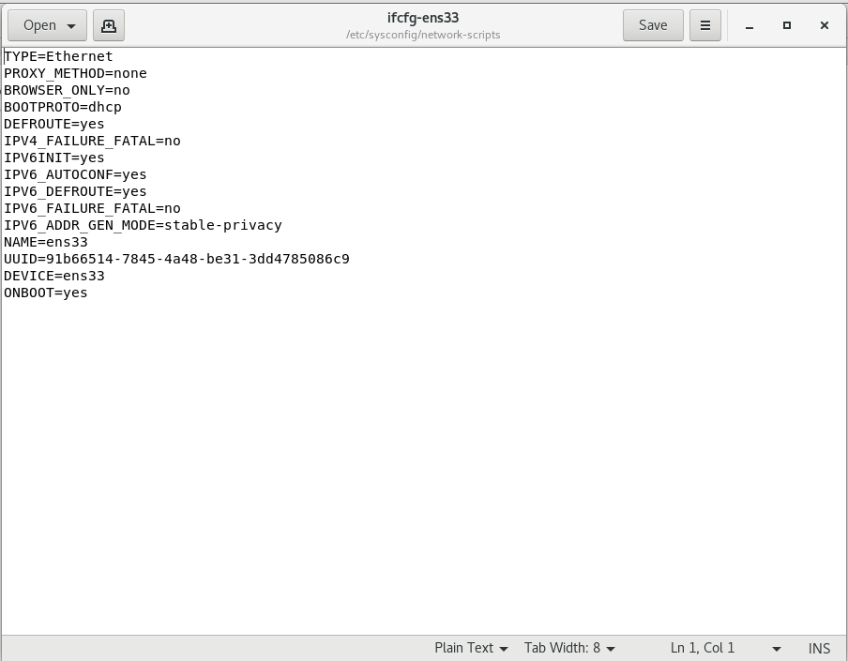
Continue Installation
Things are pretty normal after choosing installation type
Just reboot & login after installed
If you forget to select network, first boot will not enable network
Open Terminal, type in sudo gedit /etc/sysconfig/network-scripts/ifcfg-ens33
Change the last line from “ONBOOT=no” to “ONBOOT=YES”, then save & reboot
7
Notes:
Here is more detail about me. I started working as a postdoctoral research fellow at the Institute of Information Science, Academia Sinica since March 2018
During my fellowship, I have been to the Purdue University USA and the Chinese University of Hong Kong for visiting
Before my fellowship, I spent two and half years for my phd degree at the CS Department of National Tsing Hua University
My research interests mainly lies in
the next generation memory/storage architecture designs
Emerging non-volatile memory and storage technologies
Low power system designs for artificial neural networks
In the past few years, I have revived few awards and a best paper nomination at DAC conference, which is a top rated conference in the EDA field

Slide 8
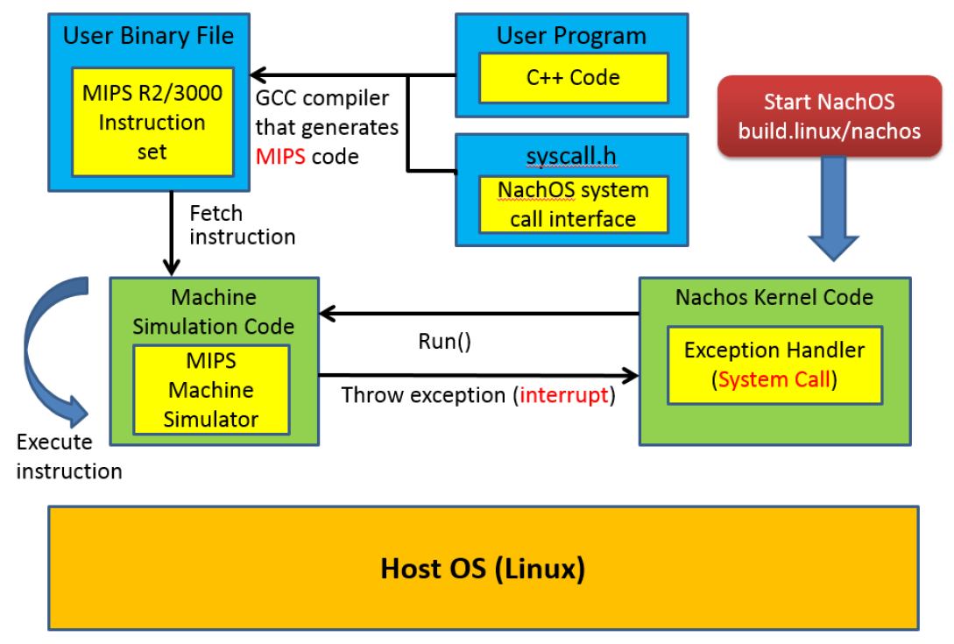
NachOS
NachOS
A process runs on top of another OS
A kernel (OS) and MIPS code machine simulator
Goal of this Project
Understand how to work on Linux machine
Understand how system call are done by OS
Go here for more information of NachOS
https://www.youtube.com/watch?v=eLQU3zlpoRQ
8
Notes:
Here is more detail about me. I started working as a postdoctoral research fellow at the Institute of Information Science, Academia Sinica since March 2018
During my fellowship, I have been to the Purdue University USA and the Chinese University of Hong Kong for visiting
Before my fellowship, I spent two and half years for my phd degree at the CS Department of National Tsing Hua University
My research interests mainly lies in
the next generation memory/storage architecture designs
Emerging non-volatile memory and storage technologies
Low power system designs for artificial neural networks
In the past few years, I have revived few awards and a best paper nomination at DAC conference, which is a top rated conference in the EDA field

Slide 9
Setup NachOS
Download & Extraction
Open browser in VM and download
https://drive.google.com/file/d/1Aispn84ruOJ8clYNPfEiEp4YLYb23BrM/view
Use whatever tools you like, extract the downloaded zip to somewhere
Prepare your environment (If you have issue with sudo, add your account to sudoer)
> cd to unzipped folder
> sudo mv ./mips-decstation.linux-xgcc.gz /
> cd /
> sudo tar -xvzf mips-decstation.linux-xgcc.gz
Install packages for compiling
> sudo yum install compat-gcc-44 compat-gcc-44-c++
> sudo yum install gcc gcc-c++
> sudo yum install glibc-devel.i686 libgcc.i686 libstdc++-devel.i686 libstdc++-devel
Remember to press y for accepting downloading packages
9
Notes:
Here is more detail about me. I started working as a postdoctoral research fellow at the Institute of Information Science, Academia Sinica since March 2018
During my fellowship, I have been to the Purdue University USA and the Chinese University of Hong Kong for visiting
Before my fellowship, I spent two and half years for my phd degree at the CS Department of National Tsing Hua University
My research interests mainly lies in
the next generation memory/storage architecture designs
Emerging non-volatile memory and storage technologies
Low power system designs for artificial neural networks
In the past few years, I have revived few awards and a best paper nomination at DAC conference, which is a top rated conference in the EDA field

Slide 10
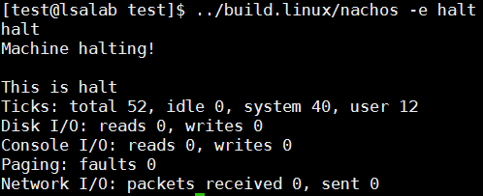
Setup NachOS
Compile
> cd NachOS-4.0_MP1
> chmod -R 777 *
> cd code/build.linux
> make clean
> make
Test your nachos
> cd NachOS-4.0_MP1/code/test
> make clean
> make halt
> ../build.linux/nachos -e halt
You should see the output as right
Congratulation, Part I is finished !
10
Notes:
Here is more detail about me. I started working as a postdoctoral research fellow at the Institute of Information Science, Academia Sinica since March 2018
During my fellowship, I have been to the Purdue University USA and the Chinese University of Hong Kong for visiting
Before my fellowship, I spent two and half years for my phd degree at the CS Department of National Tsing Hua University
My research interests mainly lies in
the next generation memory/storage architecture designs
Emerging non-volatile memory and storage technologies
Low power system designs for artificial neural networks
In the past few years, I have revived few awards and a best paper nomination at DAC conference, which is a top rated conference in the EDA field

Slide 11
Part II. : Implement System Calls
for File System Operation
Notes:
Thank you for listening. Now, I would like to end today’s talk by the Q & A time.

Slide 12
What to Implement ?
Implement a console I/O system call. -> 20%
Void PrintInt(int number)
Output the number and a line separator to the console.
Implement four file I/O system call. -> 80% (20% each)
OpenFileId Open(char *name);
Open a file with the name, and returns its corresponding OpenFileId.
Return -1 if open fails.
int Write(char *buffer, int size, OpenFileId id);
Write “size” characters from buffer into the file.
Returns number of characters actually written to the file.
If attempt writing to an invalid id, return -1.
int Read(char *buffer, int size, OpenFileId id);
Read “size” characters from the file and copy them into buffer. Returns number of characters actually read from the file.
If attempt reading from an invalid id, return -1.
12
Notes:
Here is more detail about me. I started working as a postdoctoral research fellow at the Institute of Information Science, Academia Sinica since March 2018
During my fellowship, I have been to the Purdue University USA and the Chinese University of Hong Kong for visiting
Before my fellowship, I spent two and half years for my phd degree at the CS Department of National Tsing Hua University
My research interests mainly lies in
the next generation memory/storage architecture designs
Emerging non-volatile memory and storage technologies
Low power system designs for artificial neural networks
In the past few years, I have revived few awards and a best paper nomination at DAC conference, which is a top rated conference in the EDA field

Slide 13
What to Implement ? (Cond’t)
int Close(OpenFileId id);
Close the file with id.
Return 1 if successfully close the file, 0 otherwise.
All your implements should not use any IO functions from standard libraries (e.g. printf(), cout, fopen(), fwrite(), write(), etc.). (See Slide 4)
Then, Upload your code onto our gitlab and trigger Jenkins
Commit files to local repository > git commit –am “HW01”
Push Files onto Gitlab Project > git push
Check Jenkins (See Slide 5)
No report is needed for HW01.
13
Notes:
Here is more detail about me. I started working as a postdoctoral research fellow at the Institute of Information Science, Academia Sinica since March 2018
During my fellowship, I have been to the Purdue University USA and the Chinese University of Hong Kong for visiting
Before my fellowship, I spent two and half years for my phd degree at the CS Department of National Tsing Hua University
My research interests mainly lies in
the next generation memory/storage architecture designs
Emerging non-volatile memory and storage technologies
Low power system designs for artificial neural networks
In the past few years, I have revived few awards and a best paper nomination at DAC conference, which is a top rated conference in the EDA field

Slide 14
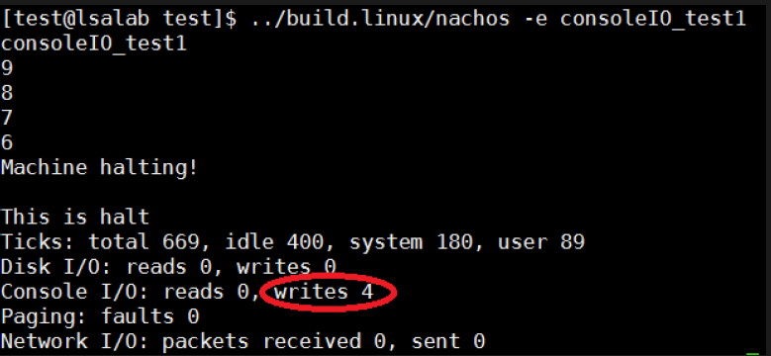
Expected Results of Requirement 1 & 2
Again, Don’t use any IO functions from standard libraries
Requirement 1
After running consoleIO_test1, the output of void PrintInt(int number) should look like
Requirement 2
After running fileIO_test1, a file named file1.test should be generated with following content
After running fileIO_test2, the output should look like
14
Notes:
Here is more detail about me. I started working as a postdoctoral research fellow at the Institute of Information Science, Academia Sinica since March 2018
During my fellowship, I have been to the Purdue University USA and the Chinese University of Hong Kong for visiting
Before my fellowship, I spent two and half years for my phd degree at the CS Department of National Tsing Hua University
My research interests mainly lies in
the next generation memory/storage architecture designs
Emerging non-volatile memory and storage technologies
Low power system designs for artificial neural networks
In the past few years, I have revived few awards and a best paper nomination at DAC conference, which is a top rated conference in the EDA field

Slide 15
Part III. Visit our GitLab website &
upload your results
Notes:
Thank you for listening. Now, I would like to end today’s talk by the Q & A time.

Slide 16
What is Git ?
Git : A tool for distributed version control
What is version control?
A system that records changes to a file or set of files over time
Why version control?
Roll back
You must have broken your program somehow, but you don’t know why
Keep track of development
Useful when multiple people works on same project
You can know who introduced a bug
16
Notes:
Here is more detail about me. I started working as a postdoctoral research fellow at the Institute of Information Science, Academia Sinica since March 2018
During my fellowship, I have been to the Purdue University USA and the Chinese University of Hong Kong for visiting
Before my fellowship, I spent two and half years for my phd degree at the CS Department of National Tsing Hua University
My research interests mainly lies in
the next generation memory/storage architecture designs
Emerging non-volatile memory and storage technologies
Low power system designs for artificial neural networks
In the past few years, I have revived few awards and a best paper nomination at DAC conference, which is a top rated conference in the EDA field

Slide 17
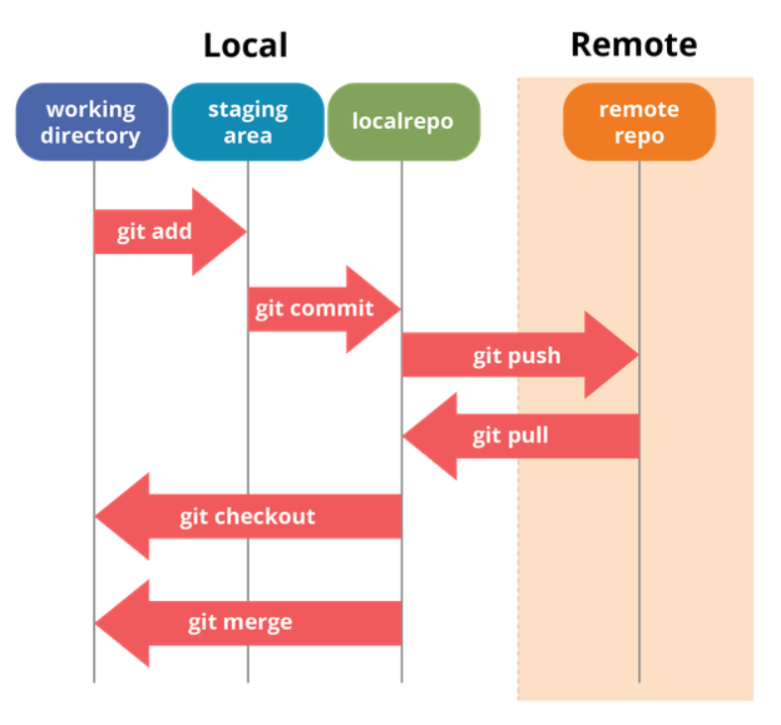
How does Git Work?
Using repository to track the revised history of files and folders
Local repository (本地)
Remote repository (遠端)
Go here for more info. of Git
https://linuxhint.com/git_tutorial_beginners/
https://blog.techbridge.cc/2018/01/17/learning-programming-and-coding-with-python-git-and-github-tutorial/
17
Notes:
Here is more detail about me. I started working as a postdoctoral research fellow at the Institute of Information Science, Academia Sinica since March 2018
During my fellowship, I have been to the Purdue University USA and the Chinese University of Hong Kong for visiting
Before my fellowship, I spent two and half years for my phd degree at the CS Department of National Tsing Hua University
My research interests mainly lies in
the next generation memory/storage architecture designs
Emerging non-volatile memory and storage technologies
Low power system designs for artificial neural networks
In the past few years, I have revived few awards and a best paper nomination at DAC conference, which is a top rated conference in the EDA field

Slide 18
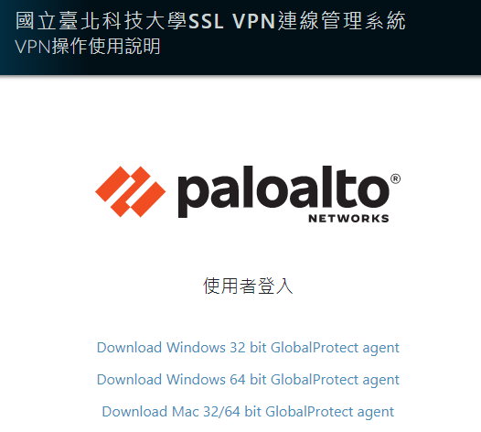
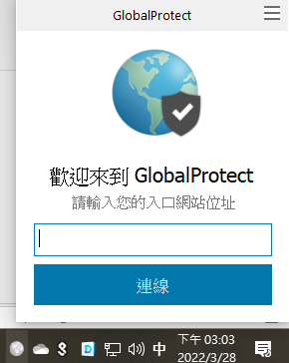
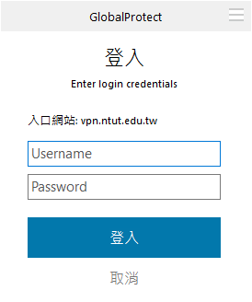
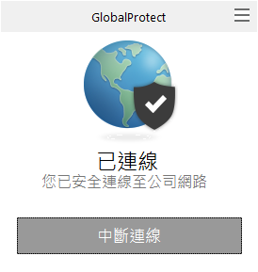
Visit Our GitLab Server
Make sure you’re in school network (Using school wifi or using VPN)
School VPN instruction (Info. Not really helpful)
Visit the website & Login with your school account: https://vpn.ntut.edu.tw/global-protect/getsoftwarepage.esp
Download the software & Install -> Enter vpn.ntut.edu.tw -> Login with school account
Our GitLab website: https://140.124.183.78/gitlab
Our online automation grading: https://140.124.183.78/jenkins/
18
Notes:
Here is more detail about me. I started working as a postdoctoral research fellow at the Institute of Information Science, Academia Sinica since March 2018
During my fellowship, I have been to the Purdue University USA and the Chinese University of Hong Kong for visiting
Before my fellowship, I spent two and half years for my phd degree at the CS Department of National Tsing Hua University
My research interests mainly lies in
the next generation memory/storage architecture designs
Emerging non-volatile memory and storage technologies
Low power system designs for artificial neural networks
In the past few years, I have revived few awards and a best paper nomination at DAC conference, which is a top rated conference in the EDA field

Slide 19
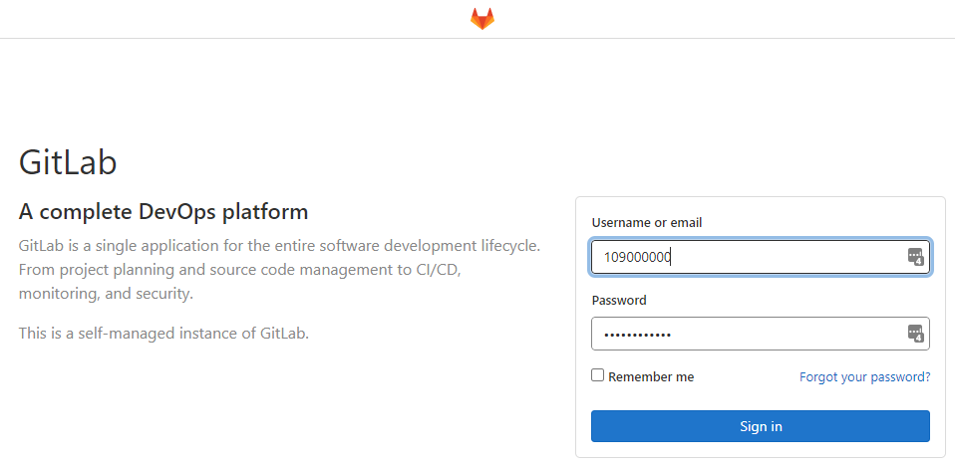
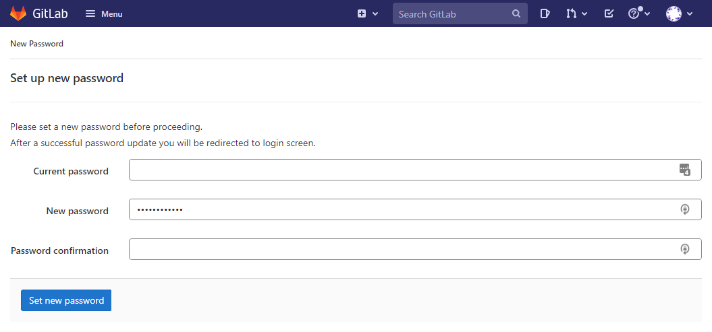
Visit Our GitLab Server (Cont’d)
Don’t worry if you see warming about the SSL certificate
It’s intranet and no registrations are allowed, so it’s safe enough for academia use
Log in with your student ID & default password is 12345678
Change that immediately after logging in
19
Notes:
Here is more detail about me. I started working as a postdoctoral research fellow at the Institute of Information Science, Academia Sinica since March 2018
During my fellowship, I have been to the Purdue University USA and the Chinese University of Hong Kong for visiting
Before my fellowship, I spent two and half years for my phd degree at the CS Department of National Tsing Hua University
My research interests mainly lies in
the next generation memory/storage architecture designs
Emerging non-volatile memory and storage technologies
Low power system designs for artificial neural networks
In the past few years, I have revived few awards and a best paper nomination at DAC conference, which is a top rated conference in the EDA field

Slide 20
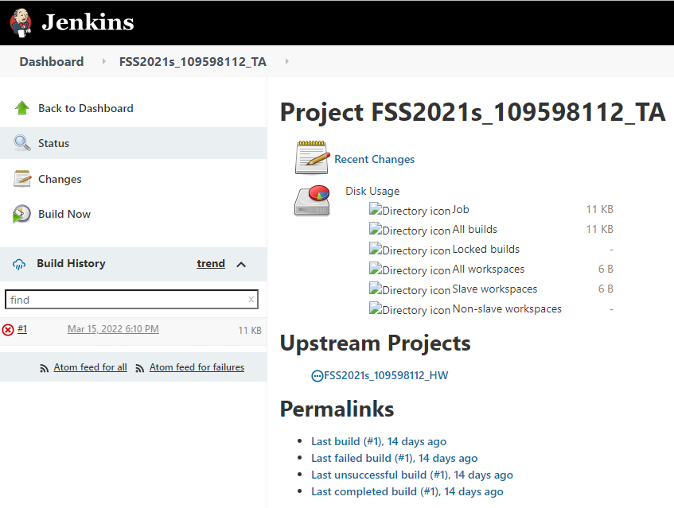
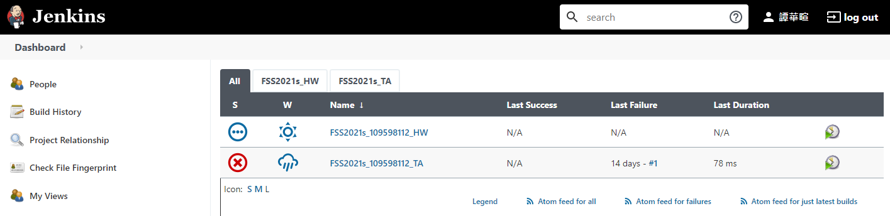
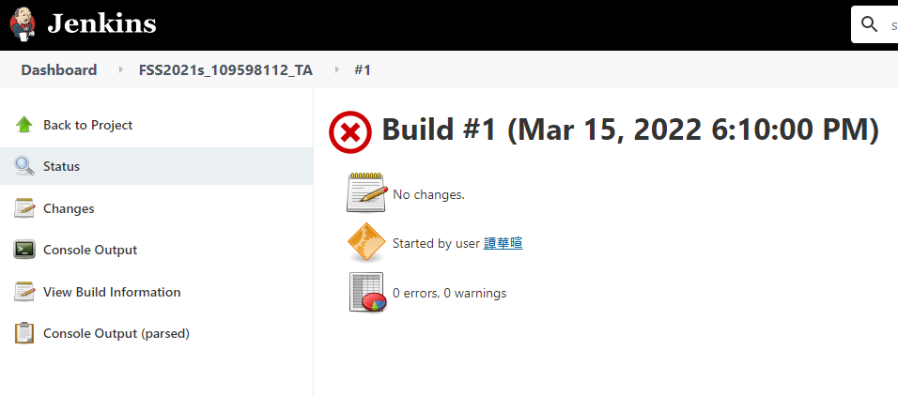
Visit Our Jenkins Server
Jenkins is used to automatically test the correctness of your homework
Log in with your student ID & default password is 12345678
Change that immediately after logging in
There are two jobs.
FSS2021s_[*]_HW is your homework with released test cases
FSS2021s_[*]_TA is your homework with TA test cases
After you push your homework to GitLab, both jobs will be triggered in series
You can find the console output to see the results of test cases
2.
3.
1.
20
Notes:
Here is more detail about me. I started working as a postdoctoral research fellow at the Institute of Information Science, Academia Sinica since March 2018
During my fellowship, I have been to the Purdue University USA and the Chinese University of Hong Kong for visiting
Before my fellowship, I spent two and half years for my phd degree at the CS Department of National Tsing Hua University
My research interests mainly lies in
the next generation memory/storage architecture designs
Emerging non-volatile memory and storage technologies
Low power system designs for artificial neural networks
In the past few years, I have revived few awards and a best paper nomination at DAC conference, which is a top rated conference in the EDA field

Slide 21
Upload Your Homework
Following steps are based on Linux Bash Terminal
So, Please do following steps in your virtual machines

Slide 22
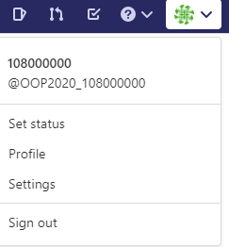
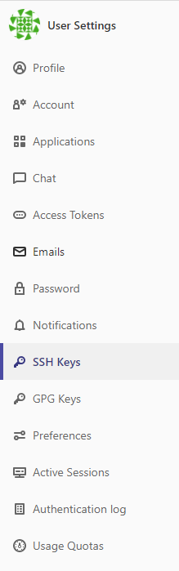
A. Setup to SSH Keys for Your Account
Select Settings from upper right cornet
Then, Select SSH keys on the left list

Slide 23
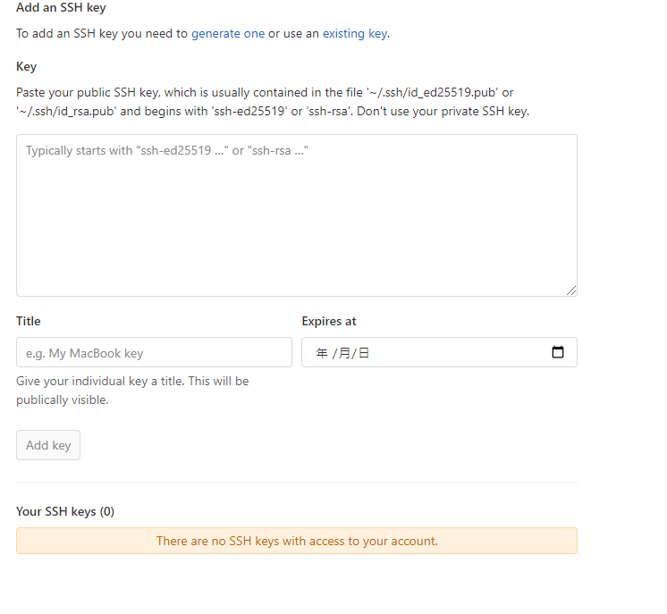
A. Setup to SSH Keys for Your Account (Cond’t)
Click generate one
Follow the description of RSA SSH keys
Open terminal on your VM

Slide 24
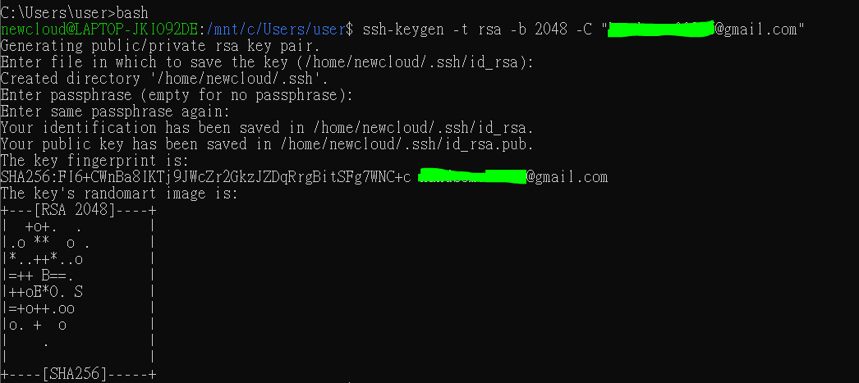
A. Setup to SSH Keys for Your Account (Cond’t)
Type in ssh-keygen -t rsa -b 2048 -C "email@example.com"
email@example.com should be changed to your school email
Press enter for running the cmd & Another enter for accepting file path
Enter your passphrase (secret token)
Then press enter until you see the key (as follow)

Slide 25
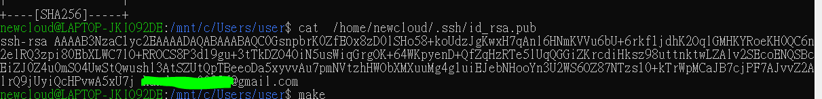
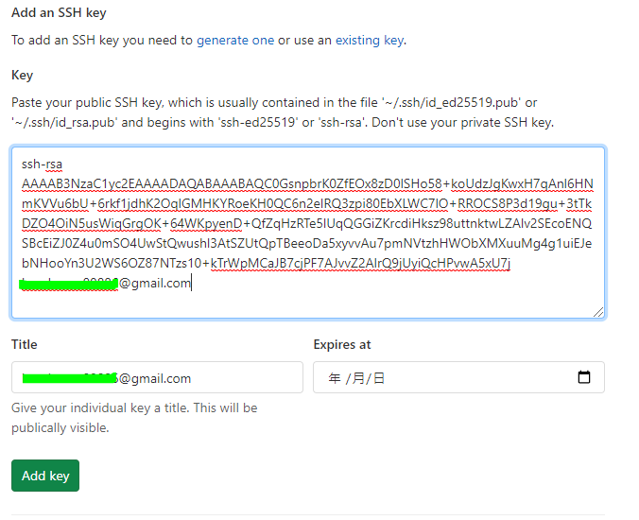
A. Setup to SSH Keys for Your Account (Cond’t)
Type in cat {where your key is stored} // the yellow box on previous slide
Then, the SSH key will be show (blue box)
Copy the content in blue box
Past the copied key to Public SSH key
Press Add key

Slide 26
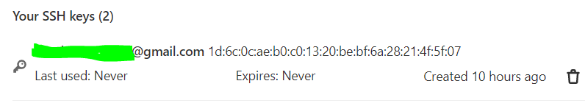
A. Setup to SSH Keys for Your Account (Cond’t)
Then
Done!

Slide 27
B. Install Git in Terminal
Go to terminal
Install git with > sudo yum install git
Check you installation > git - -version
Set information (Change the email and name)
> git config --global user.email “t109000000@ntut.edu.tw”
> git config --global user.name “Shuo-Han Chen”
27
Notes:
Here is more detail about me. I started working as a postdoctoral research fellow at the Institute of Information Science, Academia Sinica since March 2018
During my fellowship, I have been to the Purdue University USA and the Chinese University of Hong Kong for visiting
Before my fellowship, I spent two and half years for my phd degree at the CS Department of National Tsing Hua University
My research interests mainly lies in
the next generation memory/storage architecture designs
Emerging non-volatile memory and storage technologies
Low power system designs for artificial neural networks
In the past few years, I have revived few awards and a best paper nomination at DAC conference, which is a top rated conference in the EDA field

Slide 28
B. Init Your NachOS Folder for Uploading
Clean binary files of NachOS folder first
We remove binary file, because we only need to upload source code to gitlab
You only need once to this before init
> cd NachOS-4.0_MP1/code/build.linux
> make clean
> cd NachOS-4.0_MP1/code/test
> make clean
Go back to based folder of NachOS repository
> cd NachOS-4.0_MP1
> git init
Add files to be uploaded into local repository
> git add .
28
Notes:
Here is more detail about me. I started working as a postdoctoral research fellow at the Institute of Information Science, Academia Sinica since March 2018
During my fellowship, I have been to the Purdue University USA and the Chinese University of Hong Kong for visiting
Before my fellowship, I spent two and half years for my phd degree at the CS Department of National Tsing Hua University
My research interests mainly lies in
the next generation memory/storage architecture designs
Emerging non-volatile memory and storage technologies
Low power system designs for artificial neural networks
In the past few years, I have revived few awards and a best paper nomination at DAC conference, which is a top rated conference in the EDA field

Slide 29
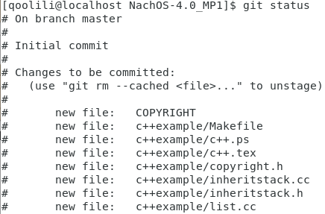
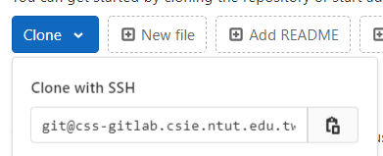
B. Set Remote Repository
Check git staus, should see lots of files
> git status
Like figures on the right
Copy your git SSH link from our gitlab
Add remote with the copied link
> git remote add origin git@....
29
Notes:
Here is more detail about me. I started working as a postdoctoral research fellow at the Institute of Information Science, Academia Sinica since March 2018
During my fellowship, I have been to the Purdue University USA and the Chinese University of Hong Kong for visiting
Before my fellowship, I spent two and half years for my phd degree at the CS Department of National Tsing Hua University
My research interests mainly lies in
the next generation memory/storage architecture designs
Emerging non-volatile memory and storage technologies
Low power system designs for artificial neural networks
In the past few years, I have revived few awards and a best paper nomination at DAC conference, which is a top rated conference in the EDA field

Slide 30
C. Git Commit & Push
Commit files to local repository
> git commit -am “HW00”
-a : commit all changed files , -m “message” : specify commit message
Push Files onto Gitlab Project
> git push -u origin master
Go to your project on our Gitlab, you should see your files on gitlab
30
Notes:
Here is more detail about me. I started working as a postdoctoral research fellow at the Institute of Information Science, Academia Sinica since March 2018
During my fellowship, I have been to the Purdue University USA and the Chinese University of Hong Kong for visiting
Before my fellowship, I spent two and half years for my phd degree at the CS Department of National Tsing Hua University
My research interests mainly lies in
the next generation memory/storage architecture designs
Emerging non-volatile memory and storage technologies
Low power system designs for artificial neural networks
In the past few years, I have revived few awards and a best paper nomination at DAC conference, which is a top rated conference in the EDA field

